Slide 1
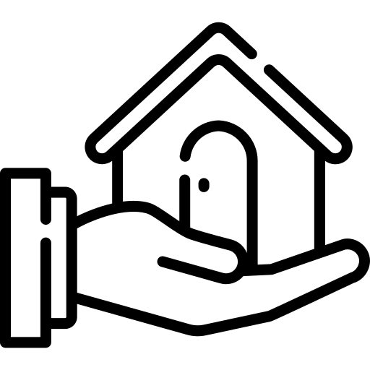
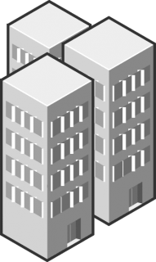



Property Management Dashboard
Real Estate
Property Analysis Report

